Slide 1
Strategic Planning, Project Management, & Marketing
HCA 346
Juliana C. Hawkins, MHA, CPC

Slide 2
Lecture Overview
Strategic Planning
Communications
SWOT Analysis
Economic Analyses
Project Management
Marketing
Notes:
Strategic planning, project management, and marketing are all essential elements for modern-day practice management. These three functions are pivotal for the overall life cycle of a practice.

Slide 3
Strategic Planning
Stakeholder Input
Surveys
Conduct SWOT Analysis
Consider each element objectively without bias
Review Stakeholder Input
Develop statement about key findings
Define Strategic Alternatives
Select Strategy
Communication with Stakeholders
Market Data
Competitor Information
Regulation
Confirm what you have heard and observed
What is our goal?
What can we do?
Does it fit our mission?
Process that will be completed
Consider the project management process
Over-communicating is impossible
Notes:
Strategy is a set of actions and policies that provide the blueprint for achieving an overall aim. Strategic Planning is defined as the process by which an organization develops and makes decisions about its strategy, or direction, which often involves the allocation of resources and a commitment to implement those decisions.
Once the mission of the organization has been examined as a starting point, the strategic product planning process can begin. A number of important steps need to be acted on. First, the practice leaders must obtain input from all stakeholders. This input may be gathered by administering surveys, examining market data, and collecting competitor information, such as where their patients come from, the hospitals they use, the services they offer, and the payment methods accepted. At this point, the practice leaders should also consider any regulatory issues to be addressed, such as a certificate of need.
The next step is to conduct a self-examination of the practice. This process, which is discussed in detail later, should include an internal and external assessment of the practice. Notice how important communication is to the strategic plan. Input from a broad base of stakeholders is essential, as is clarifying and reviewing that input and making sure all stakeholders understand the decisions that are made and why. A good communication strategy helps ensure acceptance of the decisions and engagement in the tactics for implementation. This communication strategy is an essential part of overcoming resistance to change and provides an opportunity for feedback that can improve the planning process and the success of implementation. People do not support what they do not believe, and lack of agreement leads to half-hearted efforts by members of the practice.

Slide 4
Communication
Step 1
Title your communication plan in a way that specifies the project or strategy being discussed.
Step 2
State the overall objectives of the communication plan. This step may sound simple, but it is necessary to prevent confusion about the nature of the communication.
Step 3
Identifying the individuals who receive the communications influences the level of detail, language, and format of the communication
Step 4
Establish the specific issues that must be addressed. What is the message? How must should be communicated at any given opportunity? Although over-communication is probably not a concern, people can be overloaded with information at any one time. Consider how much and what level of detail should be given on a topic.
Step 5
Determine the channel of communication that will be used. Many possibilities include: memos, an e-mail, face-to-face meetings in groups, individual meetings, press release, newsletter or blog.
Step 6
Information must be communicated in a timely fashion to afford little opportunity for misinterpretation or for rumors and distortions to circulate among members and staff of the practice. Often, practice managers and leaders take an undue amount of time to communicate because they are crafting the perfect message. In the process they fail to get the communication our immediately, creating unnecessary anxiety or allowing a distorted sense of reality to develop through the rumor mill, which then requires tremendous effort to correct.
Notes:
This may be an opportune time to address a pervasive presence in every office setting, including the medical practice: the rumor mill or grapevine. The rumor mill is an informal channel of communication in which information courses quickly through the organization, but it is information that is often inaccurate, incomplete, or intended to distort the truth. Effective practice managers are conscious of the rumor mill or grapevine and provide accurate, timely communication to prevent people from using the rumor mill as their primary source of information. Having a communication plan helps ensure that people are informed, feel included, and are able to deflect rumors with facts.

Slide 5
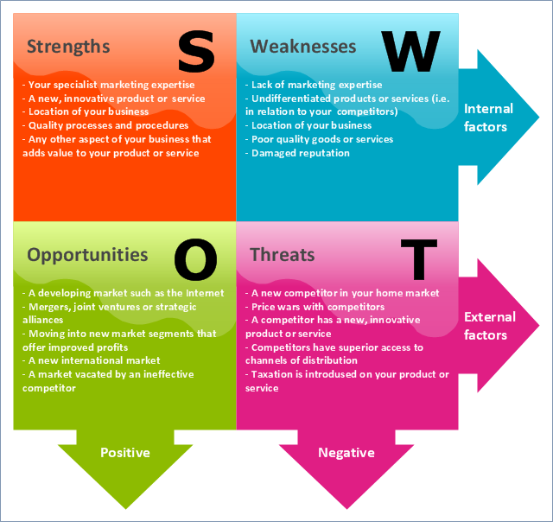
SWOT Analysis
Notes:
Among the most useful tools in strategic planning is the SWOT Analysis, which stands for strengths, weaknesses, opportunities, and threats. The SWOT analysis is a self-examination of these attributes from an internal and external stakeholder perspective. This process can be difficult to perform effectively because it is often hard to critically examine oneself without introducing bias, such as overestimating one’s strengths, underestimating weaknesses, exaggerating opportunities, and minimizing threats. Therefore, the SWOT analysis facilitator is a valuable participant who establishes proper ground rules for conducting the exercise in a way that provides the most useful information. Simply trying to confirm the excellence of the practice is not useful in moving forward. Recognizing ad capitalizing on strengths is important, but equally important is to be realistic about all the SWOT elements.
The SWOT analysis is often conducted as a face-to-face activity. SWOT sessions are designed to be versatile and thus can be appropriate for the overall performance of the practice or can address a specific area of concern. The textbook contains a great list of best practices for performing a SWOT analysis. The keys to remember are that Strengths and Weaknesses are INTERNAL factors and Opportunities and Threats are EXTERNAL factors.
Much of what takes place in today’s practice management environment is in response to the changing external healthcare environment. Change management is discussed in detail later in the course. The Force Field Analysis was created by Kurt Lewin as a tool to take the SWOT process a step further and to help medical practices understand the barriers to implementing ideas or changes identified in the SWOT. When forces seeking to push a change forward are equal to the forces that push against the change, the situation will not change. To overcome the deadlock, the forces that seek change must be greater than the forces that oppose it. Force field analysis provides a useful visual tool to examine the forces that encourage and oppose change.
Participants in the force field analysis discussion can use a template, as shown in Exhibit 5.4 in the textbook, to discuss the barriers creating resistance to change and to design interventions that help to overcome that resistance. A force field analysis Is an effective way for stakeholders to collectively examine a barrier and devise plausible solutions to overcome it.

Slide 6
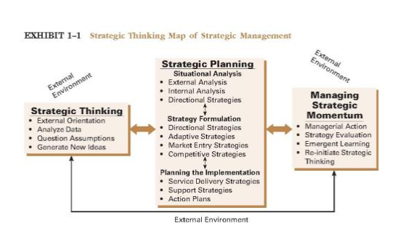
Strategic Thinking Mapping
Notes:
Visualize Strategic Thinking and how to map out the various stages of strategy management. Analysis of the external environment is a key part of strategy planning and the SWOT analysis.

Slide 7
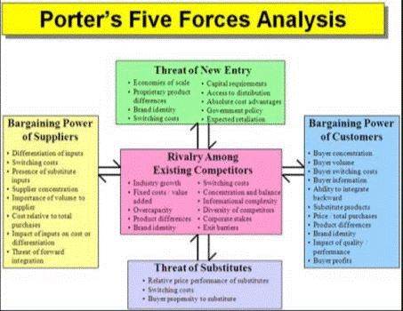
Porter’s 5 Forces
Notes:
Read the additional article on Porter’s 5 Forces located on the Blackboard course site.

Slide 8
Economic Analyses
Market Assessments
Capital Investing
  Breakeven Analysis
  Payback Analysis
  Internal Rate of Return
Notes:
Strategic planning often indicates the need for a practice to offer a new service. The decision to add a service typically involves answering several questions such as those outlined in your textbook. When contemplating a new service, practice leaders must be realistic in the estimation of revenue and be clear about the basis for their financial projections. Some approaches to determining the expected volume of service includes:
Conducting a market assessment
Base decisions on data while being aware of bias and oversimplifications of the results
Ask providers to account for the number of services ordered in a given time
Examine payer information and determine service frequency
Consult specialty societies for information about a particular service
Employ a consultant to evaluate the business case for the new service
Capital Investing requires that a practice completes key analyses to determine viability of purchasing large plant, property, and equipment. There are four primary methods that are used to determine the financial viability of a capital investment:
Breakeven Analysis: allows managers to determine the number of services needed in order to break even when considering fixed costs and variable costs. Computed based on the following formula:
Breakeven point = Fixed Costs/(Unit selling price – variable costs)
Payback Analysis: has similarities to breakeven analysis in that both are easy to calculate and interpret. However, unlike breakeven analysis, payback analysis gives an answer in terms of time rather than monetary units. Payback Analysis is computed based on the following formula:
Payback period in years = Initial Investment/Annual Cash Flow = Years to pay back initial investment
Net Present Value Analysis: provides information about viability in financial terms. NPV is calculated by:
NPV = [Rx (1-(1+i)^{-n})/1]-initial investment
Where Rx is net cash inflow expected for each period, with net cash flow equal to total revenue minus total expenses
i is the required rate of return per period, which may be established by the practice as a reasonable return on investment or may be the interest rate the practice must pay to borrow money for the capital investment
n is the number of periods during which the project is expected to operate and generate cash inflows
Internal Rate of Return Analysis: often-used method of evaluating capital investment, albeit a significantly more complicated approach than the other methods discussed in the chapter. IRR is calculated by:
0= P₀ + [P₁/(1+IRR)] + [P₂/(1+IRR) ₂] + [P₃/(1+IRR) ₃] + … + [P_{n}/(1+IRR) _{n}]
Where P₀, P₁, … P_{n} equals the cash flows in periods 1, 2,….n, respectively and IRR equals the projects rate of return. The problem with this formula is that one must use trial and error to determine the IRR as the equation cannot be solved without knowing IRR.
There are many advantages and disadvantages to each of these analyses. These are outlined in your textbook in Exhibit 3.5.

Slide 9
Project Management
Strategic Planning
Communicate Project
Plan & Design
Closeout/Reflection
Execute Project
Manage Project
Notes:
Regardless of the decision the practice makes regarding a given plan or project, the success of the endeavor greatly depends on how well it is managed. Project management skills are essential for the effective practice manager. The necessary skills for high-quality project management have been defined in a number of ways, however, there are a few skills that are vitally important:
Communication
Scope
Initiation
Quality Management
Organization Management
Time Management
Project Integration Management
Cost Management
Risk and Issue Management

Slide 10
Marketing
Product
Place
Promotion
Price
Notes:
Marketing is defined by the four P’s:
Product
Place
Promotion
Price
Preparing a marketing plan can involve a SWOT analysis or a 2x2 situational matrix. Rising consumerism has caused a significant shift in the expectations of patients and presents new challenges to the medical practice. They are the direct result of an increase in managed care imposing restrictions on patients’ access to care, the growing cost of care, and the lack of involvement of patients and families in their care, all leading to the rise of the patient-centered medical practice.
The first step in marketing a medical practice is to create a marketing plan. A marketing plan includes: Analysis of the relevant market and the practice’s objectives, key strategic issues, milestones to the primary objectives, budget and media decisions, and timeline. See Exhibits 5.12 and 5.13 for examples of marketing planning.

